Slide 1


Oracle database
Lecture 10

Slide 2

Today’s Agenda
Operators In Oracle
Formatting Columns
Some Queries Based On Operators
Pattern Matching

Slide 3
Operators In Oracle
Operators are symbols or words that represents an action or process.
An Operator is capable of manipulating operands and returning a result.
All Oracle operators have been divided into 5 categories.

Slide 4
Operators In Oracle
They are listed below:
Arithmetic Operators
Comparison Operators
Logical Operators
Set operators ( We will discuss them later in the course)
Miscellaneous Operators

Slide 5
Arithmetic Operators
Arithmetic operators manipulate numeric operands as well as date operands
There are 6 Arithmetic operators in Oracle and they are:
Operator | Description
+ (unary) | Makes operand positive
- (unary) | Negates operand
/ | Division (numbers and dates)
* | Multiplication
+ | Addition (numbers and dates)
- | Subtraction (numbers and dates)

Slide 6
Comparison Operators
Comparison operators are used in conditions and compare one expression with another .
The result of a comparison can be TRUE, FALSE, or UNKNOWN.
Operator | Description
= | Equality Operator
<>, !=, ^= | Not Equality Operator
> | Greater Than Operator
< | Less Than Operator
>= | Greater Than or Equal to Operator
<= | Less Than or Equal to Operator

Slide 7
Logical Operators
Logical operators combine the results of two-component conditions to produce a single result.
Logical operators provided by Oracle are:
Operator | Description
AND | Logical Conjunction Operator
OR | Logical Disjunction Operator
NOT | Logical Negation Operator

Slide 8
Miscellaneous Operators
Following are a few more built-in operators which can’t be categorized in any of the previous categories so we call them miscellaneous operators.
Operator | Description
| | | Concatenation
IN , NOT IN | Comparison for a value in a specified list
BETWEEN , NOT BETWEEN | Comparison based on range of values
LIKE , NOT LIKE | Used for pattern matching
IS ,IS NOT | Used for comparing NULL values

Slide 9
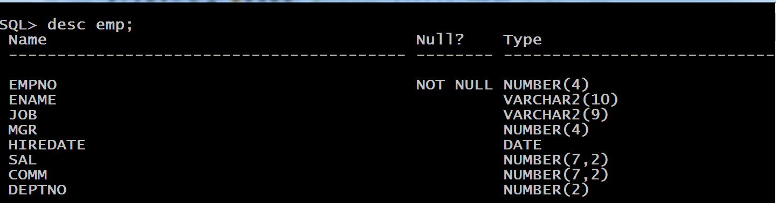
Sample Table
To practice the operators we have discussed , let’s create a sample table called Emp with the following structure:
Also populate Emp table with some dummy data.

Slide 10
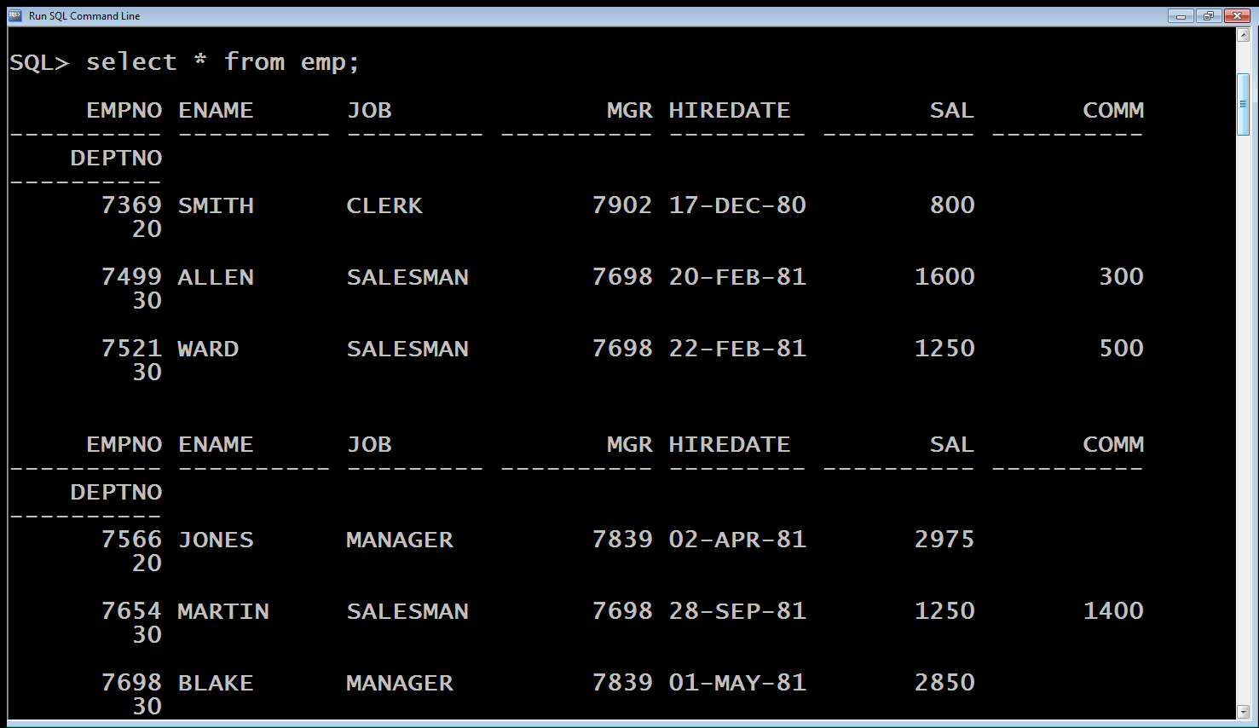
Sample Table
Now , if we display it’s contents using the select command then the output looks very uneven , because Oracle reserves a space of almost 10 characters for Number columns and column width for char & varchar2 columns in SQL* Plus.

Slide 11
Sample Table
To solve this issue we must use format command, whose general syntax is:
Column <column_name> format <format_details>;
Format details , are dependent on the type of column we want to format.

Slide 12
Sample Table
For numbers , we use the number 9 as many times as we want max number of digits.
For example, to set the width of sal column to 5 digits we would write :
Column sal format 99999;

Slide 13
Sample Table
For varchar2, we use the pattern AX where X is the number indicating the width we want to set.
For example, to set the width of ename column to 4 characters we would write :
Column ename format A4;
The format model will stay in effect until we reset the column's format, or exit from SQL*Plus

Slide 14
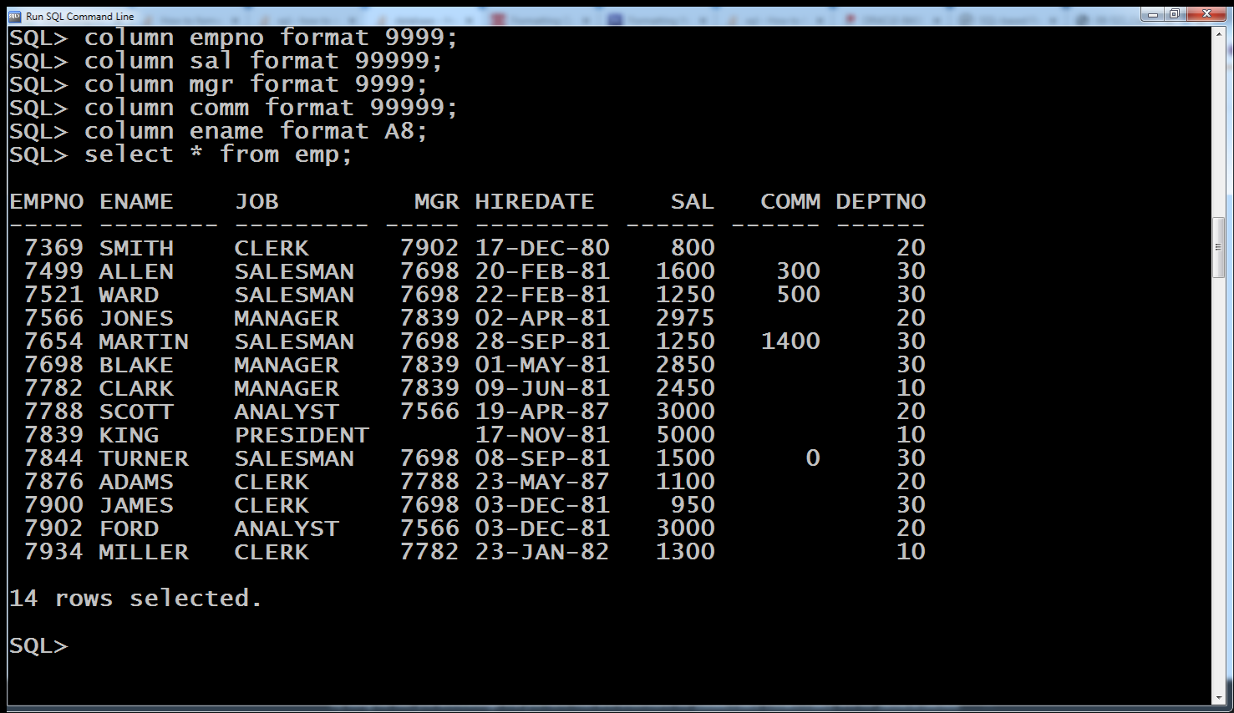
Sample Table

Slide 15
Queries
WAQ to display name and salary of every employee.
Select ename,sal from emp;
Modify the above query so that output consists of employees working in department no 10 only.
Select ename,sal from emp where deptno=10;

Slide 16
Queries
WAQ to display name of every employee along with his total income.
Select ename,sal+comm as income from emp;
The output of the above query will be surprising .
This is because for those employees whose commission is NULL , Oracle will not even display salary .
Rather it will display sum of sal and comm as NULL.
This is because in Oracle any arithmetic operation on NULL returns NULL

Slide 17
Queries
WAQ to display name and salary of all the employees who earn from 3000 to 5000.
Select ename,sal from emp where sal>=3000 and sal <=5000;
Another way to write the above query is to use the operator BETWEEN

Slide 18
Queries
The BETWEEN operator allows us to specify a range to test.
When you use the BETWEEN operator to form a search condition for rows returned by a SELECT statement, only rows whose values are in the specified range are returned.
Syntax of the BETWEEN operator:
expression [ NOT ] BETWEEN low AND high
The low and high specify the lower and upper values of the range to test and they can be literals or expressions.

Slide 19
Queries
WAQ to display name and salary of all the employees who earn from 3000 to 5000.
Select ename,sal from emp where sal BETWEEN 3000 and 5000;

Slide 20
Queries
WAQ to display name and salary of all the employees who do not earn from 3000 to 5000.
Select ename,sal from emp where sal < 3000 OR sal >5000;
OR
Select ename,sal from emp where sal NOT BETWEEN 3000 AND 5000;

Slide 21
Queries
WAQ to display name and salary of all the employees who earn 1000 , 1500 0r 3000.
Select ename,sal from emp where sal =1000 OR sal=1500 OR sal=3000;
Another way to write the above query is to use the operator IN

Slide 22
Queries
The IN operator of Oracle ,determines whether a value matches any values in a list
Syntax of Oracle IN operator
expression [NOT] IN (v1,v2,...)

Slide 23
Queries
WAQ to display name and salary of all the employees who earn 1000 , 1500 0r 3000 .
Select ename,sal from emp where sal IN (1000,1500,3000);

Slide 24
Queries
WAQ to display name and salary of all the employees who do not earn 1000 , 1500 0r 3000 .
Select ename,sal from emp where sal != 1000 AND sal != 1500 AND sal!=3000;
OR
Select ename,sal from emp where sal NOT IN (1000,1500,3000);

Slide 25
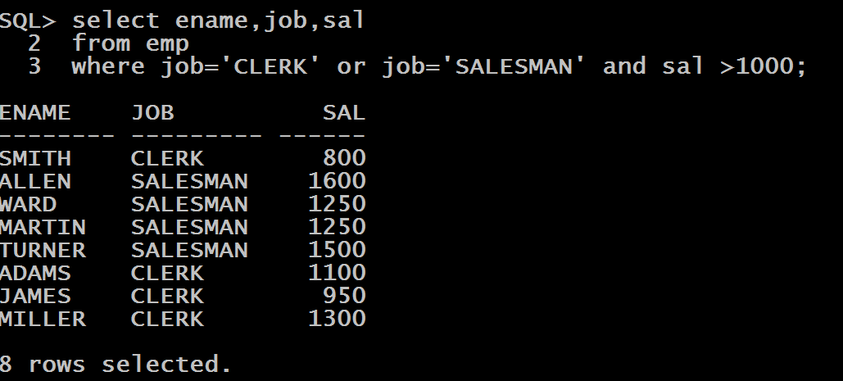
An Important Point !
WAQ to display ename, sal and job of all those CLERK and SALESMAN whose salary is greater than 1000.
If we solve the above query as:
Select ename,job,sal
From emp
Where job=‘CLERK’ or job=‘SALESMAN’ and sal >1000;
Then the output will be: ( which is wrong!)

Slide 26
Why Did It Happen ?
This happened because in Oracle the AND operator has a higher precedence than OR operator.
So the query became:
(First condition) job is CLERK.
Or:
(Second condition) job is SALESMAN And salary is greater than 1000.

Slide 27
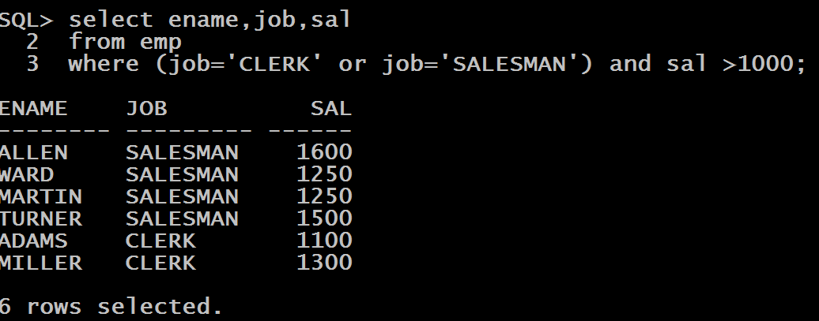
Solution
The solution is to change the ORDER OF PRECEDENCE , which is done by using round brackets .
So the correct query will be
Select ename,job,sal
From emp
Where (job=‘CLERK’ or job=‘SALESMAN’) and sal >1000;

Slide 28
Pattern Matching Using LIKE Operator
In Oracle, we may not always know the exact value to search for, sometimes we may want to select rows that match a certain character pattern.
For example:
All employees whose name starts with ‘M’
All employees whose job title ends with ‘R’
All customers whose phone number does not begin with +91
The Oracle LIKE operator is used to perform a wildcard searches and retrieve rows that match a certain character pattern.

Slide 29
Oracle WildCard Symbols
Two symbols can be used to construct the search string:
% : The percent (%) sign, represents any sequence of characters (0 or more).
_ : The underscore (_) sign, represents any single character.

Slide 30
Example
Suppose we write the query as:
SELECT product_name
FROM products
WHERE product_name LIKE '%e‘
‘%e’ – all of the product names of any length but they must end with the lower case letter ‘e’ (Case sensitive)
Values that meet this condition are, for example: ‘Coffee’, ‘Cheese’, ‘Cake’.
Theoretically, a product whose name is just ‘e’ would have also been included here, because % represents any number of characters, including zero.

Slide 31
Example
Suppose we write the query as:
SELECT product_name
FROM products
WHERE product_name LIKE '_a%'
‘_a%’ – all of the product names whose second letter is ‘a’.
The _ symbol allows any single character to appear as the first character of the name.
The second character of the name must be equal to ‘a’.
After the letter ‘a’, there is no lower or upper limit to the letters that can follow.
Values that meet this condition are, for example: ‘Pasta’, ‘waffles’ or ‘bagels’.

Slide 32
Queries
WAQ to display ename ,job and sal of every employee whose name is exactly five characters long.
Select ename,,job,sal from emp where ename LIKE ‘_____’;
WAQ to display ename ,job and sal of every employee whose name is having 2 consecutive L .
Select ename,sal from emp where ename LIKE ‘%LL%;

Slide 33
Queries
WAQ to display ename ,job and sal of every employee whose name contains 2 A.
Select ename,,job,sal from emp where ename LIKE ‘%A%A%’;
WAQ to display ename ,job and sal of every employee whose name ends with the letter S .
Select ename,sal from emp where ename LIKE ‘%S;

Slide 34
Queries
WAQ to display ename ,job and sal of every employee who have A as the third alphabet in their name
Select ename,,job,sal from emp where ename LIKE ‘__A%’;
WAQ to display ename ,job and sal of every employee whose name begins with the letter S and who also have T as the second last letter in their name.
Select ename,sal from emp where ename LIKE ‘S%T_’;

